Slide 1
Physics at UW-Stout
PhyME
Double-Major in Physics and Mechanical Engineering
Engineering 3-2 Programs Many schools have 3-2 program where you study physics for 3 years at a school, then switch to another school for 2 years studying engineering and come out with a Dual Degree in Physics and Engineering
At Stout you can do the same thing in five years without having to change schools
Scan QR Code to see flowchart
Physics Minor
Statics and Dynamics or University Physics I
University Physics II
11 credits from the following:
PHYS-139 Intro to Research
CEE-355 Applied E&M
Any PHYS-3XX
Thermodynamics (PHYS-222 or ENGR-275 or ME-390)
Classes in bold are ones you take for your major
so you only need 5 more credits for the minor
Additional Courses:
Intro to Physics Research
Intro to Quantum Mechanics
Computational Classical Physics
Solid State Physics
Applied Optics and Photonics
Advanced Physics Lab
Quantum Mechanics
Applied Electromagnetics
Computer Science I and II
Contact Prof. Zimmerman for more information:
zimmermant@uwstout.edu
Lasers, Optics, Plasmas, Computational Modeling, and Quantum Computers

Slide 2
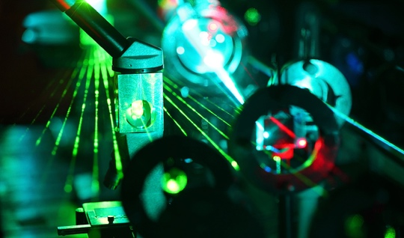
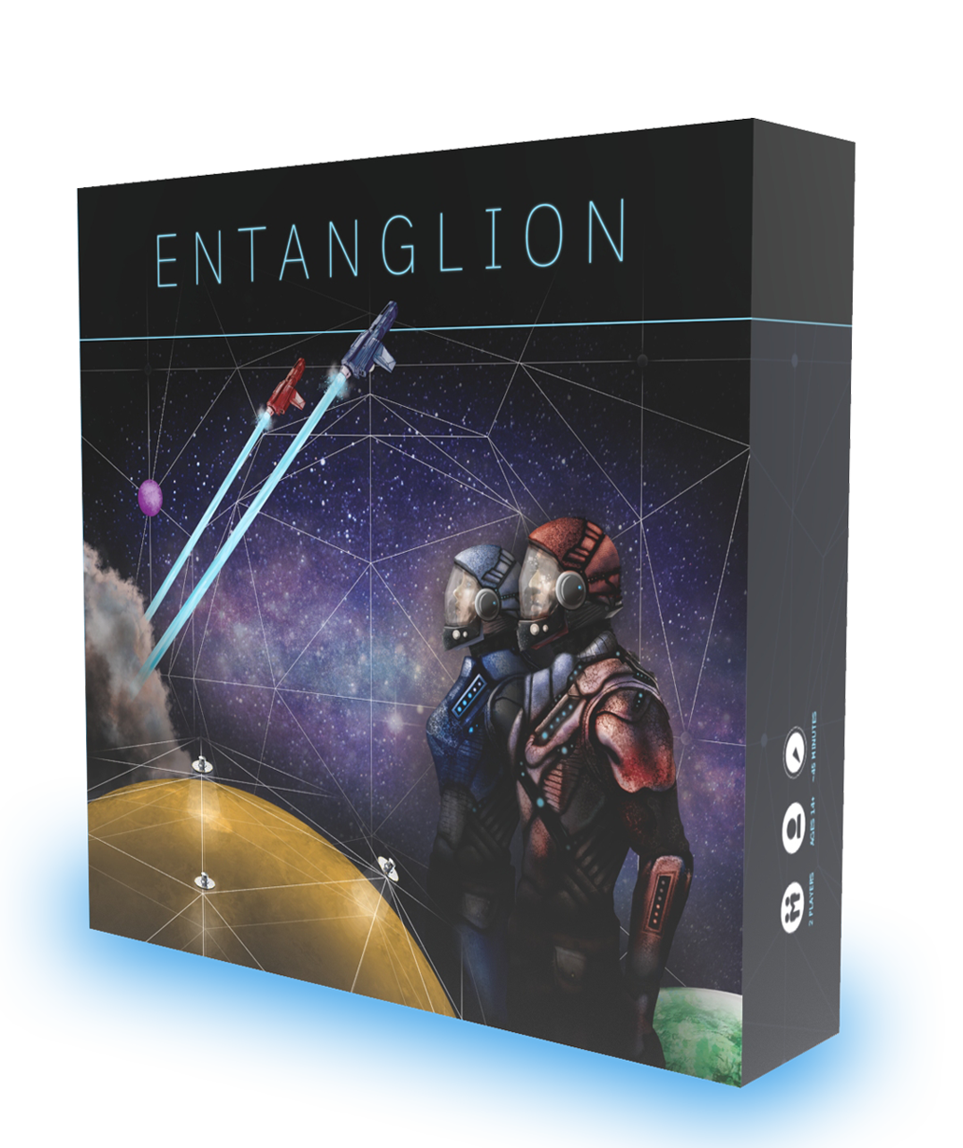
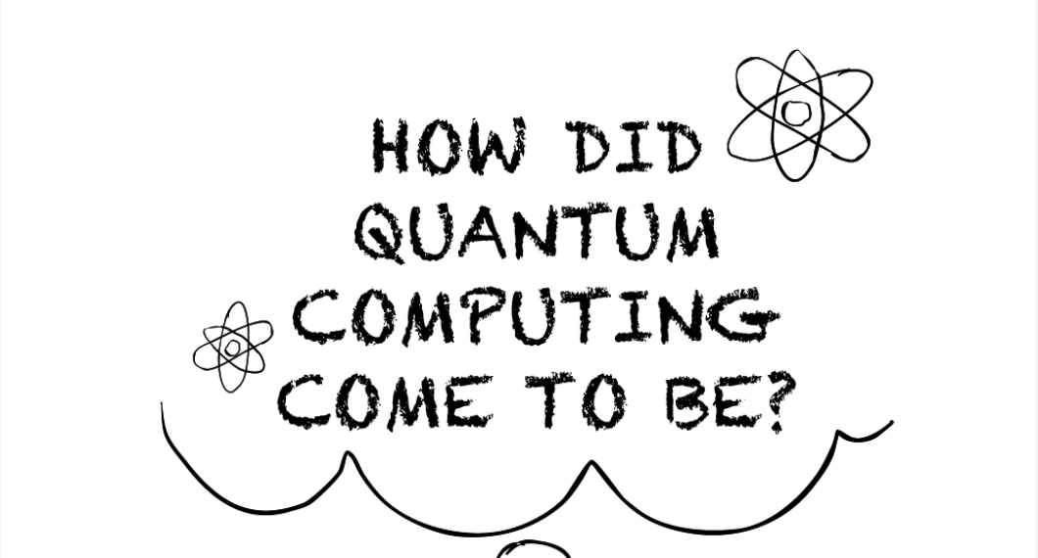
Fall Classes
Applied Optics and Photonics (PHYS-335)
PHYS-113 Quantum Revolution for Everyone FA 25, Tu/Th 1:25-2:20 (class), F 12:20-2:20 (lab) Gen Ed: ARNS with lab (3 cr), pre-req(s): none
NANO-230 – Microscopy and Materials Characterization
FA 25: MW 11:15-12:10 and lab Th 10:10-12:10
Counts as a Tech Elective for some engineering majors
All classes count towards physics major and physics minor

